Slide 1
Predicting Chances of booking cancellation using Logistics Regression
By-
Deepshi Sachan
ID: 4213188

Slide 2
ABOUT DATASETS
Source of this dataset is Kaggle.com website. (Hotel_reservations.csv)
This dataset contains 36725 observations and 19 variables.
Contains different attributes of hotel reservations like type of room reserved by the customer, Number of weekend nights, type of meal plan booked, etc.
Used Logistic Regression model to forecast the chances of booking cancellation.
Transformed Categorical variable (booking status) to Numerical. (0- Not Cancelled, 1- Cancelled)

Slide 4
Verifying the correlation between our variables.
No Strong Correlation

Slide 5
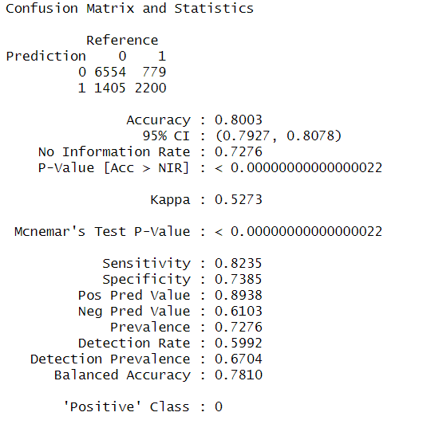
Logistic Regression Model
Ratio of training to test dataset is 7:3.
Model trained on the train dataset.
Model tested on test dataset and results are shown below.

Slide 6
Checking the most important variables of the model
Lead_time is by far the most important predictor variable, followed by no_of_special_request, and average price per room.

Slide 7
CONCLUSION
Model Accuracy is 80.03%.
Most important variable for predicting is Lead_time, followed by Average price per room and no. of special guest.
(0 = Not Cancelled, 1 = Cancelled)

Slide 8
Thank You

Slide 9
APPENDIX

Slide 10
Data Dictionary
Booking_ID: unique identifier of each booking
no_of_adults: Number of adults
no_of_children: Number of Children
no_of_weekend_nights: Number of weekend nights (Saturday or Sunday) the guest stayed or booked to stay at the hotel
no_of_week_nights: Number of weeknights (Monday to Friday) the guest stayed or booked to stay at the hotel
type_of_meal_plan: Type of meal plan booked by the customer:
required_car_parking_space: Does the customer require a car parking space? (0 - No, 1- Yes)
room_type_reserved: Type of room reserved by the customer. The values are ciphered (encoded) by INN Hotels.
lead_time: Number of days between the date of booking and the arrival date
arrival_year: Year of arrival date
arrival_month: Month of arrival date
arrival_date: Date of the month
market_segment_type: Market segment designation.
repeated_guest: Is the customer a repeated guest? (0 - No, 1- Yes)
no_of_previous_cancellations: Number of previous bookings that were canceled by the customer prior to the current booking
no_of_previous_bookings_not_canceled: Number of previous bookings not canceled by the customer prior to the current booking
avg_price_per_room: Average price per day of the reservation; prices of the rooms are dynamic. (in euros)
no_of_special_requests: Total number of special requests made by the customer (e.g. high floor, view from the room, etc)
booking_status: Flag indicating if the booking was canceled or not.

